Slide 1
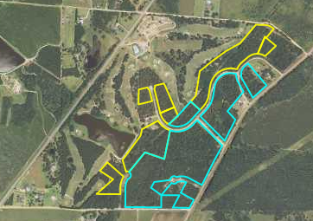
Wanee Lake Country Club
AtlantaLandGroup.com
DEVELOPMENT OPPORTUNITY
Cannon Rd
Ashburn, Georgia 31714
John Brantley
678.350.5498
jbrantley@AtlantaLandGroup.com

Slide 2
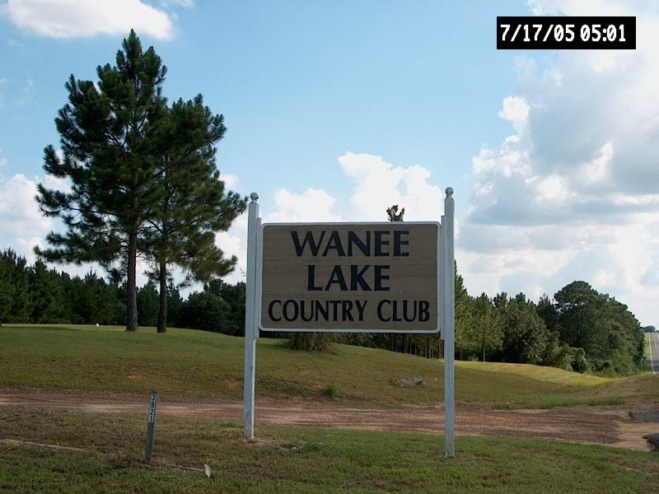
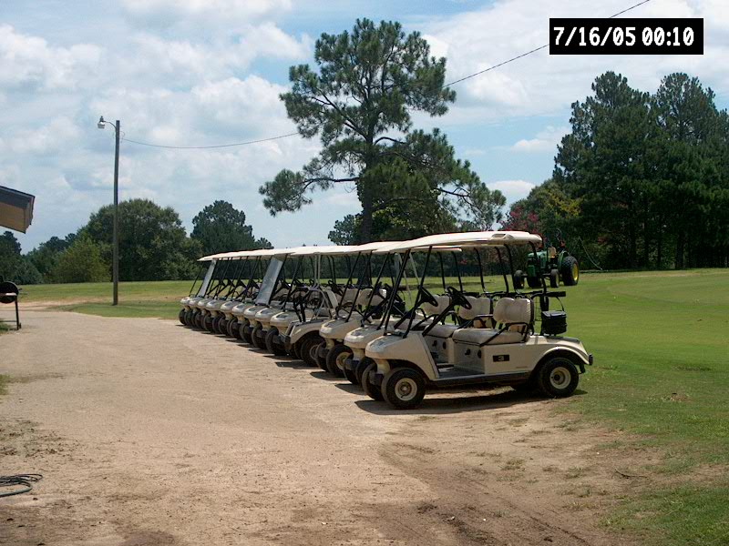
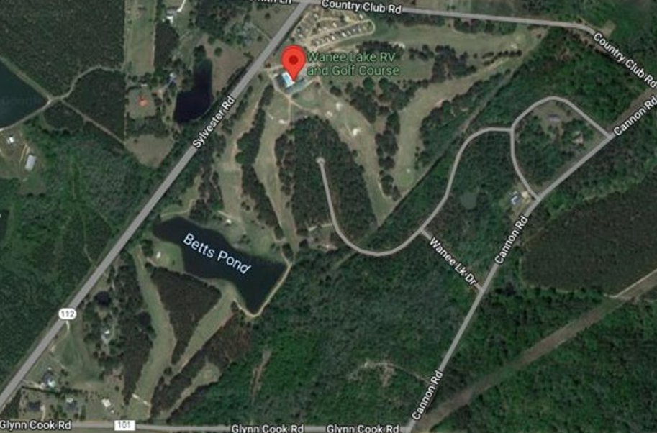
PROPERTY OVERVIEW
WLCC
WLCC
+/- 73.3 Total Acres
Turner County
Zoned Residential
Proposed subdivision-
47 lots ranging from 1.08 to 2.84 acres
16 golf course lots
Swim and tennis available
Approximately 5 Miles from Exit 82 on I-75
Approximately 26.5 Miles from Tifton
Offering Price - $1,500,000
Posey Rd
Notes:
+/- 28.5 Acres
Road Frontage:
+/- 2,000 FT Butner Rd.
+/- 600 FT Union Rd
Future developments by 2035 – Rural Neighborhood
2 miles to Camp Creek Parkway
Assigned Schools:
Stonewall Tell Elementary
Sandtown Middle School
Westlake High School

Slide 3
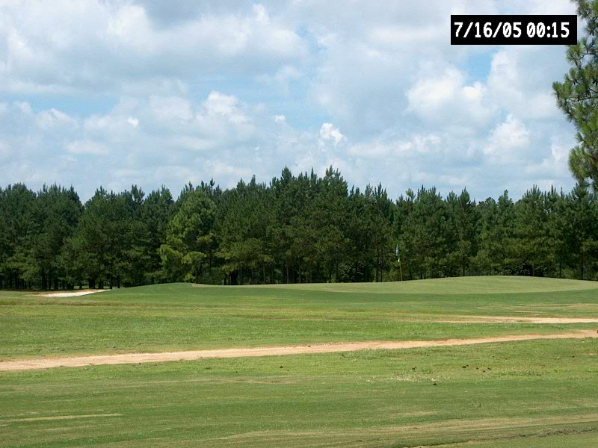
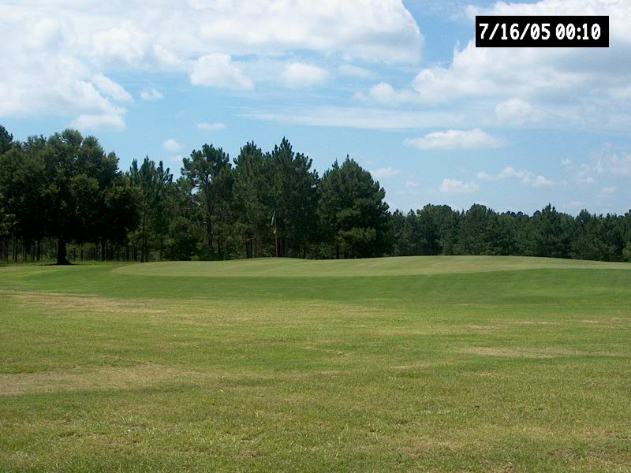
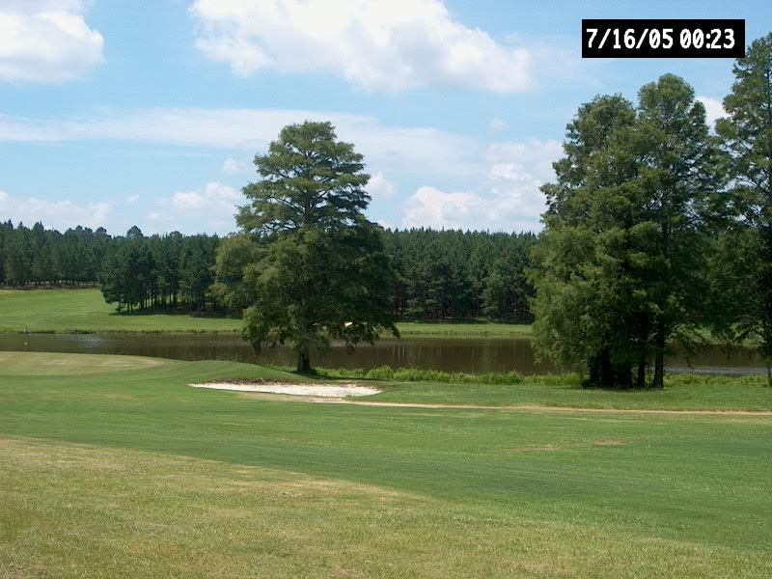
PROPERTY OVERVIEW
WLCC
WLCC
Posey Rd
WLCC
Notes:
+/- 28.5 Acres
Road Frontage:
+/- 2,000 FT Butner Rd.
+/- 600 FT Union Rd
Future developments by 2035 – Rural Neighborhood
2 miles to Camp Creek Parkway
Assigned Schools:
Stonewall Tell Elementary
Sandtown Middle School
Westlake High School

Slide 4
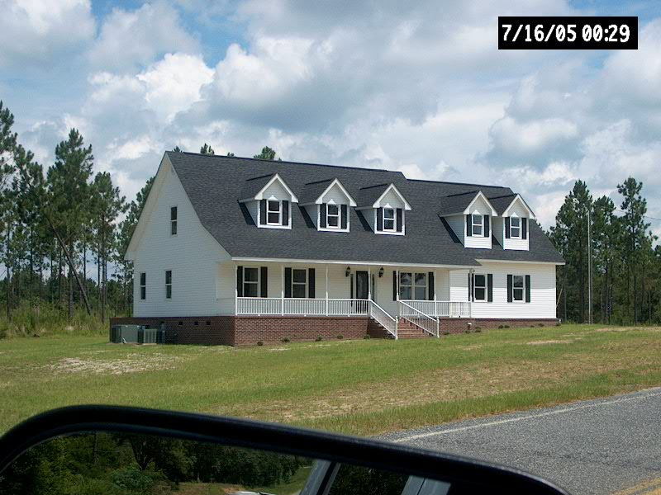
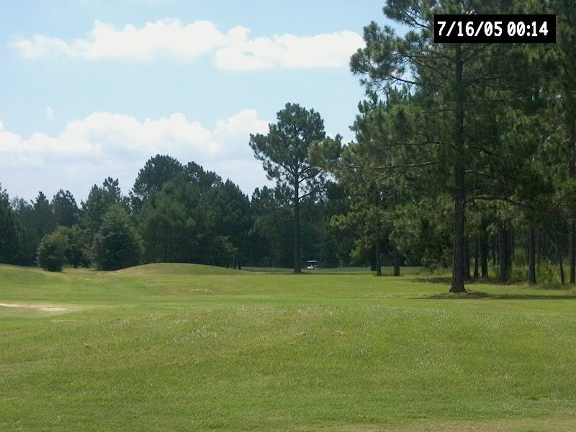
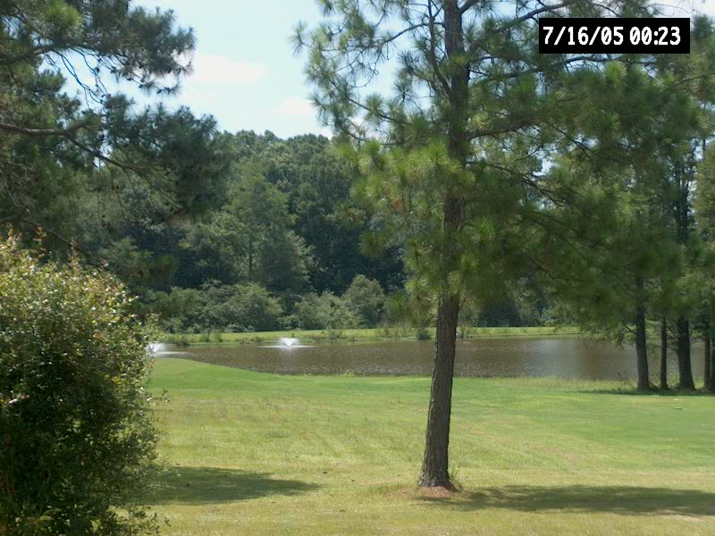
PROPERTY OVERVIEW
WLCC
WLCC
WLCC
Posey Rd
WLCC
WLCC
WLCC
Notes:
+/- 28.5 Acres
Road Frontage:
+/- 2,000 FT Butner Rd.
+/- 600 FT Union Rd
Future developments by 2035 – Rural Neighborhood
2 miles to Camp Creek Parkway
Assigned Schools:
Stonewall Tell Elementary
Sandtown Middle School
Westlake High School

Slide 5
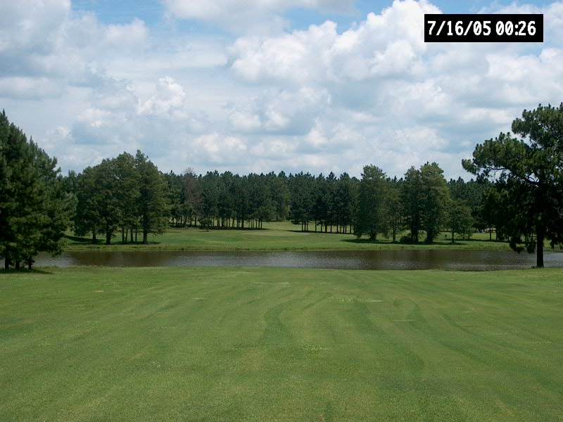
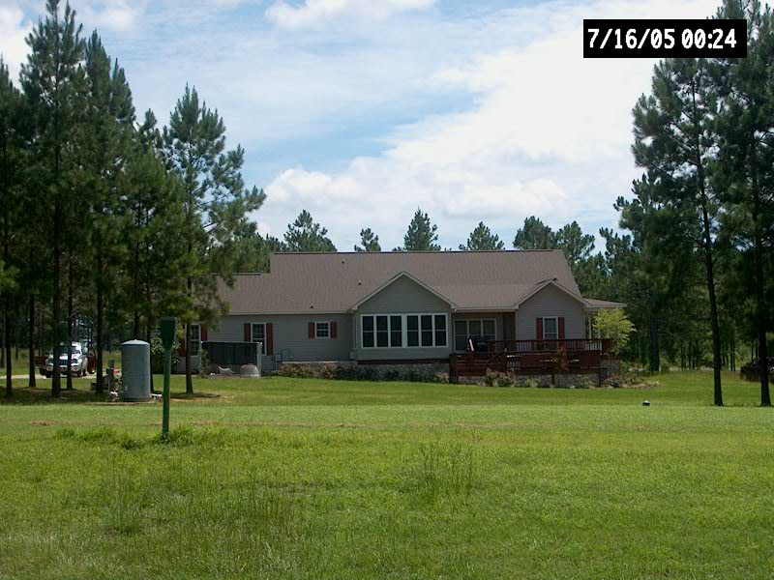
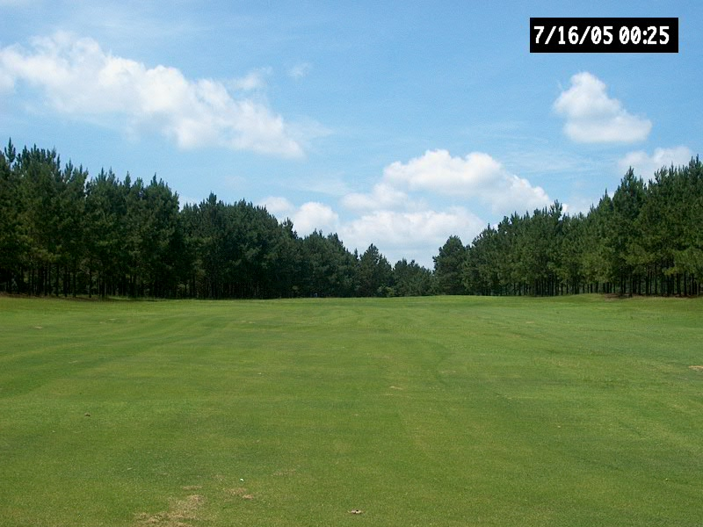
PROPERTY OVERVIEW
WLCC
WLCC
Posey Rd
WLCC
Notes:
+/- 28.5 Acres
Road Frontage:
+/- 2,000 FT Butner Rd.
+/- 600 FT Union Rd
Future developments by 2035 – Rural Neighborhood
2 miles to Camp Creek Parkway
Assigned Schools:
Stonewall Tell Elementary
Sandtown Middle School
Westlake High School

Slide 6
John Brantley
678.350.5498
jbrantley@AtlantaLandGroup.com

