Slide 1
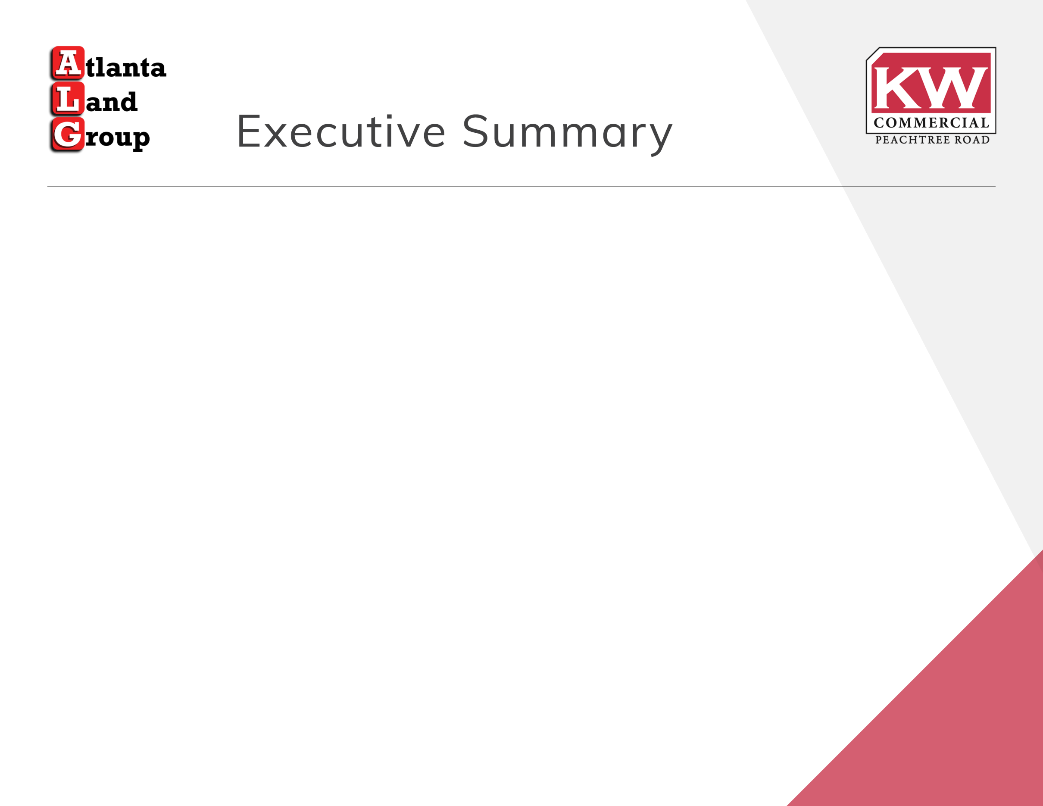

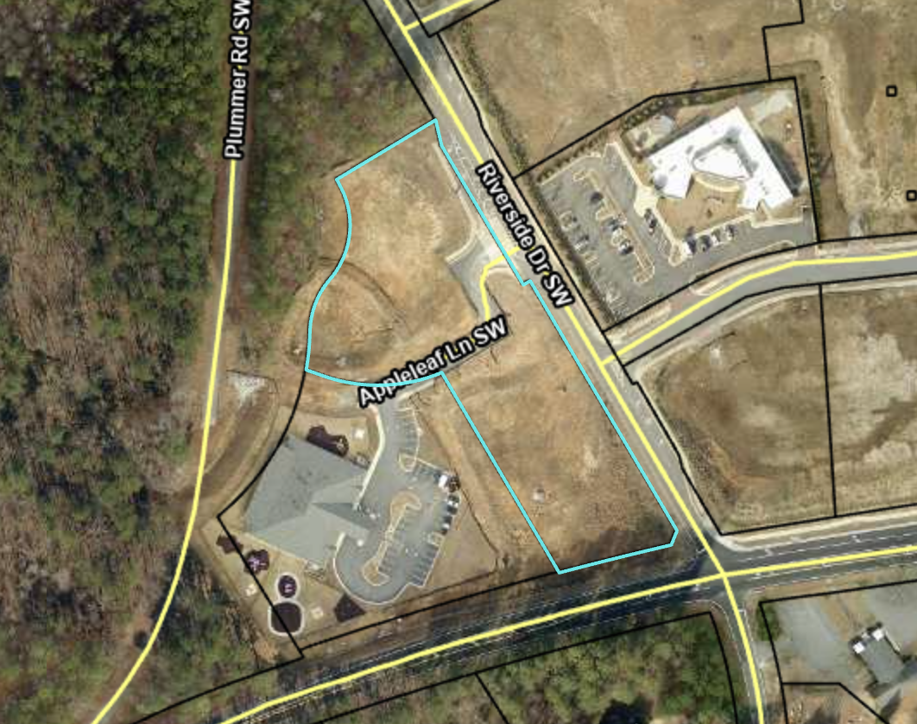
Outparcel for sale next to a Publix anchored retail center, fronting brand new Story Riverside luxury multi-family community, and south of brand-new townhome development.
Property is in the City of South Fulton; one block west of Camp Creek Parkway.
Located on Campbellton Road and Riverside Drive.
There is a need for additional retail and sit-down, causal restaurants to meet the needs of the surrounding residential development in the immediate area.

Slide 2

Campbellton Road & Riverside Parkway
ADT on Campbellton Road – 15,100 daily
ADT on Camp Creek Parkway – 35,900 daily
2.69 Acres
Pad Ready – All utilities available
Class Code: Mixed Use
Offering Price: $1,600,000
1

Slide 3

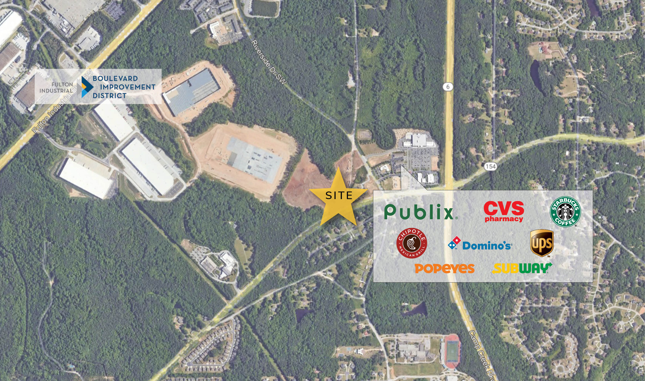

Slide 4

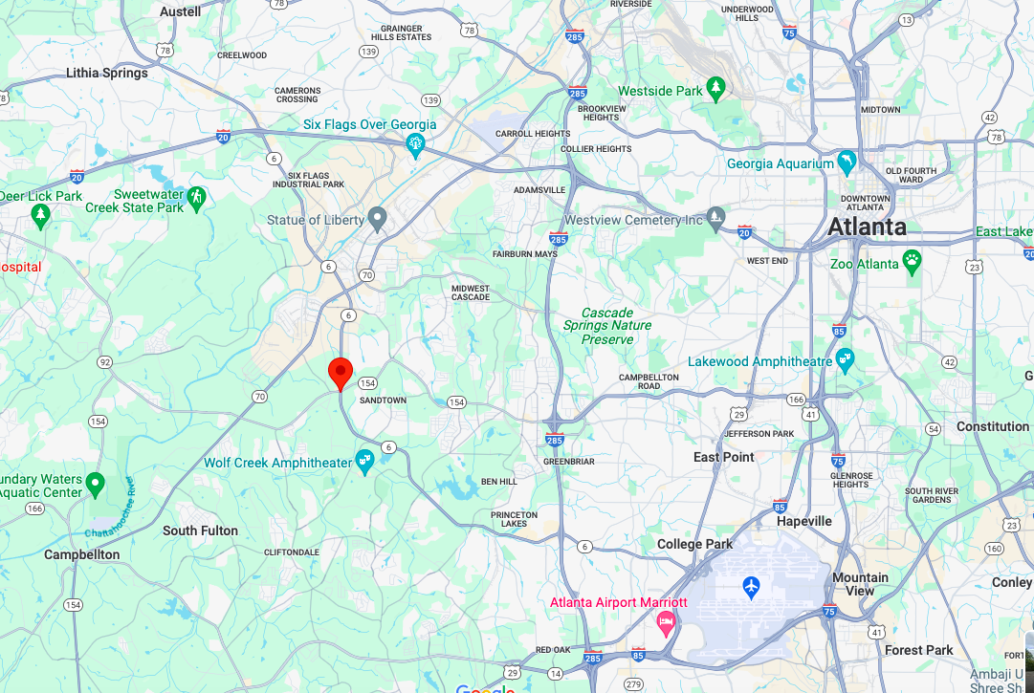


Slide 5
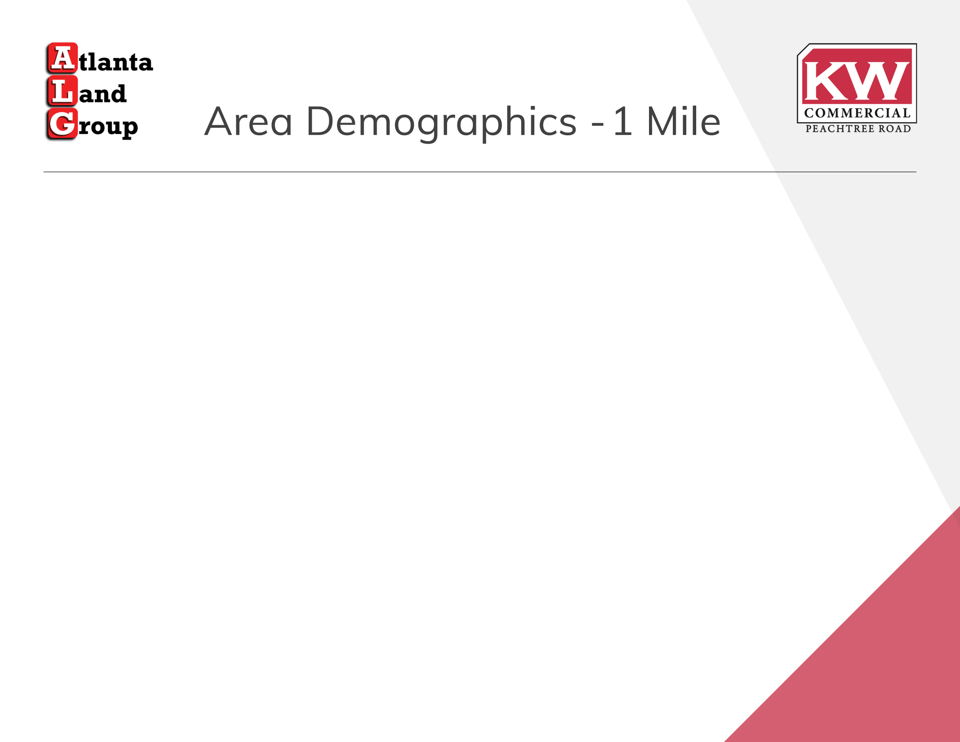
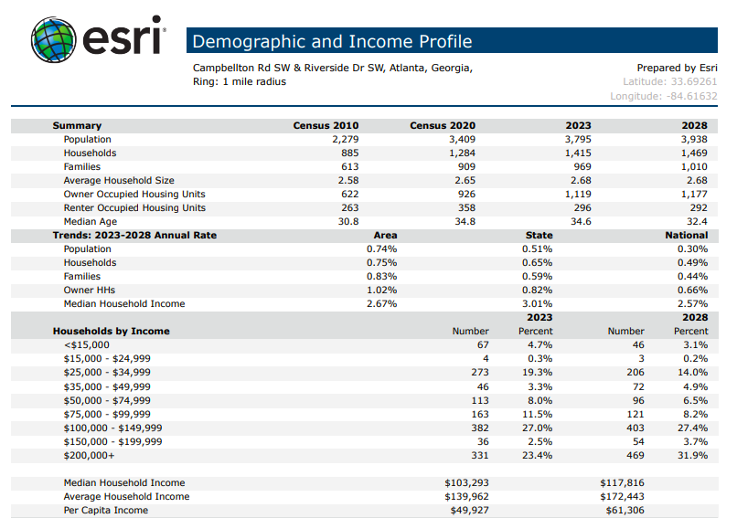

Slide 6

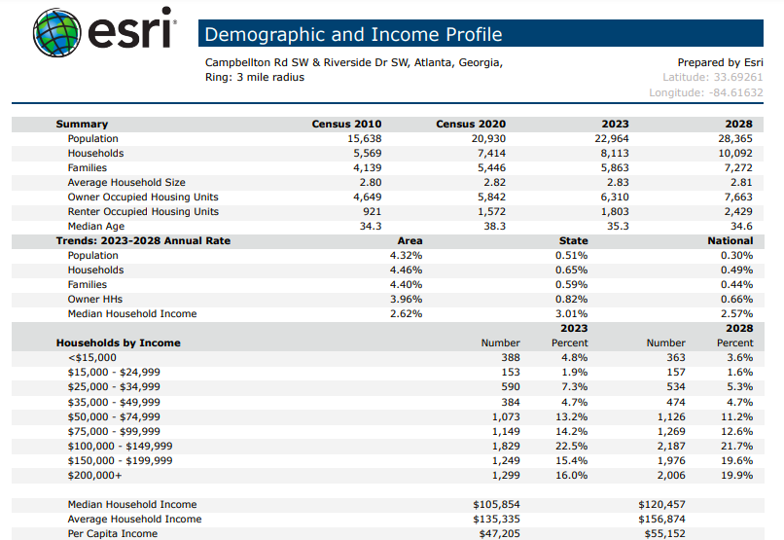

Slide 7

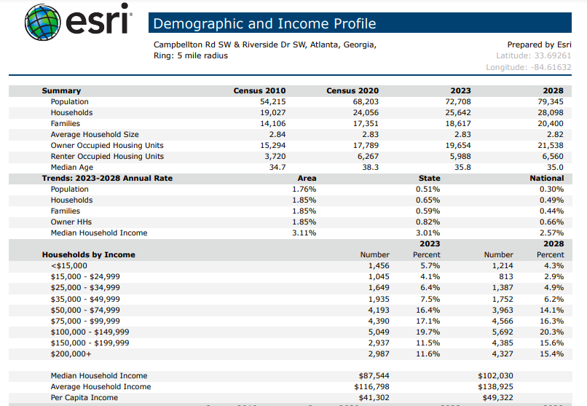

Slide 8

